Slide 1
Employee Data Analysis using Excel
STUDENT NAME: ADITI S
REGISTER NO: 322200092
DEPARTMENT: BCOM ( HONOURS)
COLLEGE: SHRI SHANKARLAL SUNDERBAI SHASUN JAIN COLLEGE FOR WOMEN

Slide 2
PROJECT TITLE
Employee Performance Analysis using Excel

Slide 3


AGENDA
Problem Statement
Project Overview
End Users
Our Solution and Proposition
Dataset Description
Modelling Approach
Results and Discussion
Conclusion
3/21/2024 Annual Review

Slide 4

PROBLEM STATEMENT
Identify Strengths and Weaknesses:
Understand where employees excel and where they may need additional support or training.
Improve Productivity:
By analyzing performance data, organizations can find ways to boost employee productivity and overall efficiency.
Enhance Employee Development:
Identify areas where employees may need further training or development to reach their full potential.
Align Goals with Organizational Objectives:
Ensure that individual and team goals align with the broader goals of the organization, fostering a more cohesive and effective workforce.
Reward and Recognition:
Help identify top performers who deserve recognition, rewards, or promotions, boosting morale and motivation across the team.

Slide 5

PROJECT OVERVIEW
Data Collection: Gather data on employee performance metrics such as sales figures, project completion rates, attendance records, customer feedback, and any other relevant KPIs.
Data Organization: Use Excel to organize and structure the data for easy analysis. This will include creating tables, sorting data, and categorizing information.
Analysis: Perform various analyses using Excel tools like pivot tables, charts, and statistical functions to extract meaningful insights.
Visualization: Create visual representations of the data to highlight trends, comparisons, and key findings, making the data more accessible for decision-makers.
Reporting: Generate a comprehensive report summarizing the analysis, key findings, and actionable recommendations for management.
.

Slide 6



WHO ARE THE END USERS?
Human Resources (HR) Department
Senior Management
Team Leaders and Managers
Employees
Learning and Development (L&D) Teams

Slide 7

OUR SOLUTION AND ITS VALUE PROPOSITION
Conditional formatting- missing
Filter – remove
Formula – =IFS(Z8>=5,"VERY HIGH",Z8>=4,"HIGH",Z8>=3,"MED","TRUE","LOW")
Pivot – summary
Graph – data visualization

Slide 8
Dataset Description
Employee Information
Performance Metrics
Behavioral and Soft Skills
Training and Development
Feedback and Appraisals
Compensation and Benefits
Promotions and Career Progression
Attendance and Punctuality
Recognition and Rewards
Demographic Information

Slide 9

THE "WOW" IN OUR SOLUTION
Formula- performance level
=IFS(Z8>=5,"VERY HIGH",Z8>=4,"HIGH",Z8>=3,"MED","TRUE","LOW")
3/21/2024 Annual Review
9

Slide 10
MODELLING
Data Collection
Employee performance metrics
Data Preprocessing
Data Cleaning
Data Normalization
Feature Selection
Defining KPIs
Key performance indicators
Descriptive Analytics
Trend Analysis
Segmentation
Visualization
Predictive Modeling
Regression Analysis
Classification Models
Time Series Analysis
10

Slide 11
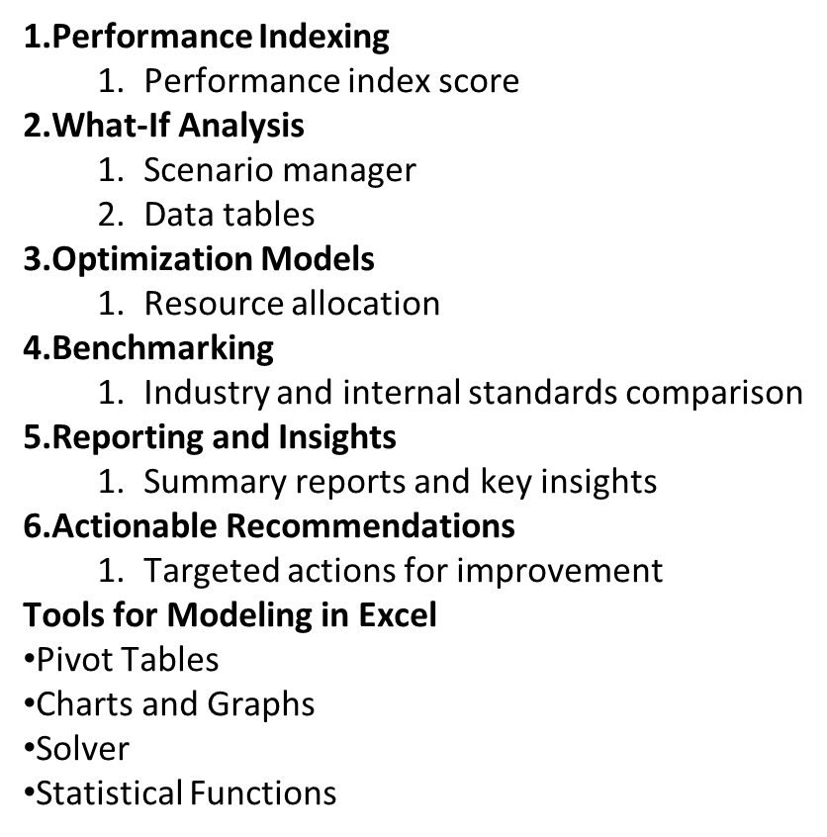

Slide 12
RESULTS
12

Slide 13
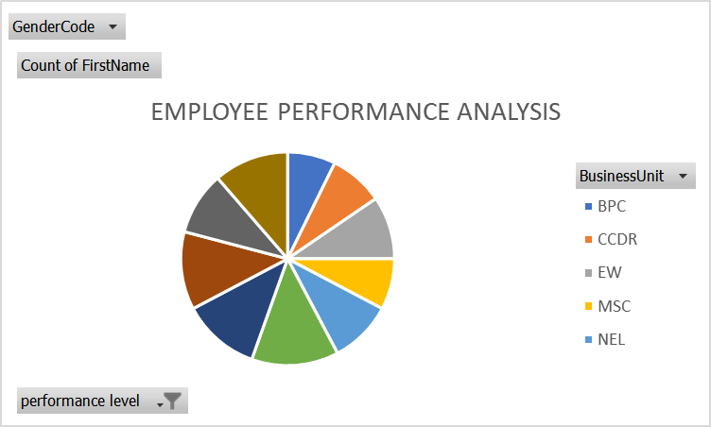

Slide 14
conclusion
Employee performance analysis is a crucial practice for any organization aiming to achieve sustained success. By systematically evaluating the performance of employees, organizations can identify strengths, address weaknesses, and make informed decisions that benefit both the individual and the organization as a whole. This analysis not only supports effective management and development of talent but also ensures that the organization's goals are met through a motivated and high-performing workforce. Ultimately, regular and thorough employee performance analysis leads to improved productivity, higher employee satisfaction, and better overall organizational performance

